Slide 1
Making Predictions: Regression
Jamil Bhanji
with a little help from Andy Field

Slide 2
Aims
Understand the linear model and its assumptions
Understand how we assess the fit of the model
Understand how we interpret model parameters
Understand how to assess the generalizability of the model

Slide 3
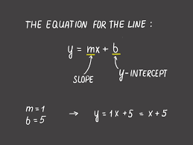
Do you remember…?
Thank your math teachers!

Slide 4
Do you remember…?

Slide 5
What is the Linear Model?
A way of predicting the value of one variable from another.
It is a hypothetical model of the relationship between two variables.
The model used is a linear one.
Therefore, we describe the relationship using the equation of a straight line.

Slide 6
Describing a Straight Line
slope
$${\text{y}}_{i}=\left(b_{0}+b_{1}X_{i}\right)+{\text{ε}}_{i}$$
y-intercept
error
b_{i}
Coefficient for the predictor
Slope (gradient) of the line
Direction/strength of relationship
b₀
Intercept (predicted value of Y when X = 0)
Point at which the regression line crosses the Y-axis (ordinate)

Slide 7
Intercepts and slopes

Slide 8
Linear Model with One Predictor

Slide 9
The Model as an Equation
With several predictors the model is described using a variation of the equation of a straight line.
$$Y_{i}=\left(b_{0}+b_{1}X_{1i}+b_{2}X_{2i}+⋯+b_{n}X_{ni}\right)+ε_{i}$$
Notes:
A similar equation can be derived in which each predictor variable has its own coefficient, and the outcome variable is predicted from a combination of all the variables multiplied by their respective coefficients plus a residual term (see equation above).
Y is the outcome variable, β₁ is the coefficient of the first predictor (X₁), β₂ is the coefficient of the second predictor (X₂), β_{n} is the coefficient of the n^{th} predictor (X_{n}), and ε_{i} is the difference between the predicted and the observed value of Y for the i^{th} subject. In this case, the model fitted is more complicated, but the basic principle is the same as simple regression. That is, we seek to find the linear combination of predictors that correlate maximally with the outcome variable.

Slide 10
b₀
b₀ is the intercept.
The intercept is the value of the Y variable when all Xs = 0.
This is the point at which the model plane crosses the Y-axis (vertical).

Slide 11
Beta Values
b₁ is the coefficient for variable 1.
b₂ is the coefficient for variable 2.
b_{n} is the coefficient for n^{th} variable.

Slide 12
Error
$$\text{Total} \text{error}= \sum_{i=1}^{n}{{\left({observed}_{i}−{model}_{i}\right)}^{2}}$$

Slide 13
The Fit of the Model?
The model based on the data might not reflect reality.
We need some way of testing how well the model fits the observed data.
How?
F statistic
R² coefficient of determination

Slide 14
Sums of squares
SS_{T} is in the ”Total” row in SPSS output
SS_{R} is in the ”Residual” row in SPSS output
SS_{M} is in the ”Regression” row in SPSS output
Notes:
SS_{T}
Total variability (variability between scores and the mean).
SS_{R}
Residual/error variability (variability between the model and the actual data).
SS_{M}
Model variability (difference in variability between the model and the mean).

Slide 15
Summary
SS_{T}
Total variability (variability between scores and the mean).
SS_{R}
Residual/error variability (variability between the model and the actual data).
SS_{M}
Model variability (difference in variability between the model and the mean).

Slide 16
F-statistic
Looks at whether the variance explained by the model (SS_{M}) is significantly greater than the error within the model (SS_{R})
It tells us whether using the regression model is significantly better at predicting values of the outcome than using the mean

Slide 17
Testing the Fit: F-statistic
SS_{T}
Total variance in the data
SS_{M}
SS_{R}
Improvement due to the model
Error in the model
If the model results in better prediction than using the mean, then we expect SS_{M} to be much greater than SS_{R}

Slide 18
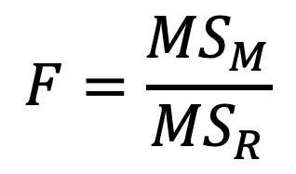
Testing the Fit: F-statistic
Mean Squared Error
Sums of Squares are total values.
They can be expressed as averages.
These are called Mean Squares, MS
$$F=\frac{{MS}_{M}}{{MS}_{R}}$$

Slide 19
R and R²
R
The correlation between the observed values of the outcome, and the values predicted by the model.
R²
The proportion of variance accounted for by the model.
Notes:
Adj. R²
An estimate of R² in the population (shrinkage).

Slide 20
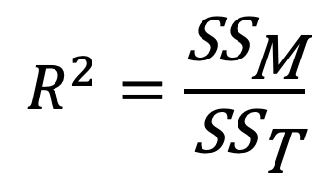
Testing the Fit: R²
R²
The proportion of variance accounted for by the regression model.
The Pearson correlation coefficient squared
$$R^{2}=\frac{{\text{SS}}_{\text{M}}}{{\text{SS}}_{\text{T}}}$$

Slide 21
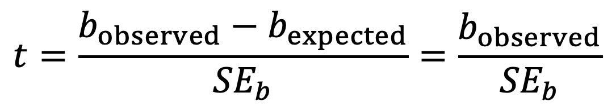
Individual Predictors
$$t=\frac{b_{observed}−b_{expected}}{{SE}_{b}}=\frac{b_{observed}}{{SE}_{b}}$$

Slide 22
Building the Model: Hierarchical Entry
Known predictors (based on past research) are entered into the regression model first
New predictors are then entered in a separate step/block
Researcher makes the decisions

Slide 23
Hierarchical Entry
It is the best method:
Based on theory testing.
You can see the unique predictive influence of a new variable on the outcome because known predictors are held constant in the model.
Bad point:
It relies on the researcher having a strong model beforehand!

Slide 24
Forced Entry
All variables are entered into the model simultaneously.
The results obtained depend on the variables entered into the model.
It is important, therefore, to have good theoretical reasons for including a particular variable.

Slide 25
Stepwise entry
Variables are entered into the model based on mathematical criteria.
Computer selects variables in steps.

Slide 26
Stepwise Entry
Step 1
SPSS looks for the predictor that can explain the most variance in the outcome variable.
Step 2:
Having selected the 1st predictor, a second one is chosen from the remaining predictors.
The semi-partial correlation (think back to the last lecture) is used as a criterion for selection.

Slide 27
Problems with Stepwise Entry
Reliance on a mathematical criterion
Variable selection may depend upon only slight differences in the semi-partial correlation
These slight numerical differences can lead to major theoretical differences
Should be used only for exploration

Slide 28
Bias: Outliers
Notes:
This is an example where an outlier has a high residual (not so high influence)

Slide 29
Bias: Outliers & Influential Cases
Notes:
Example where an outlier has a low residual (high influence)
for outliers and influential cases you have to think about what is going on in the real world outside of your data table – here, district 8 is a commuting district where few people live
if a case is a significant outlier but is not having an influence (e.g., Cook’s distance is less than 1, DFBetas and DFFit are small) there is no real need to worry about that point because it’s not having a large impact on the model parameters. Nevertheless, you should still be interested in why the case didn’t fit the model

Slide 30
Generalizing the model
We hope to be able to generalize the sample model to the entire population.
To do this, several assumptions must be met.
Violating these assumptions stops us generalizing conclusions to our target population.

Slide 31
Assumptions (a reminder…)
Additivity and linearity
Spherical residuals
Homoscedasticity: For each value of the predictors the variance of the error term should be constant
Independent residuals: for any pair of observations, the error terms should be uncorrelated.
Notes:
Additivity and linearity: The outcome variable should, in reality, be linearly related to any predictors, and, with several predictors, their combined effect is best described by adding their effects together.
Homoscedasticity: when the variances are very unequal there is said to be heteroscedasticity. Violating this assumption invalidates confidence intervals and significance tests
Independent residuals: This eventuality is sometimes described as a lack of autocorrelation – time series data can bring up this issue

Slide 32
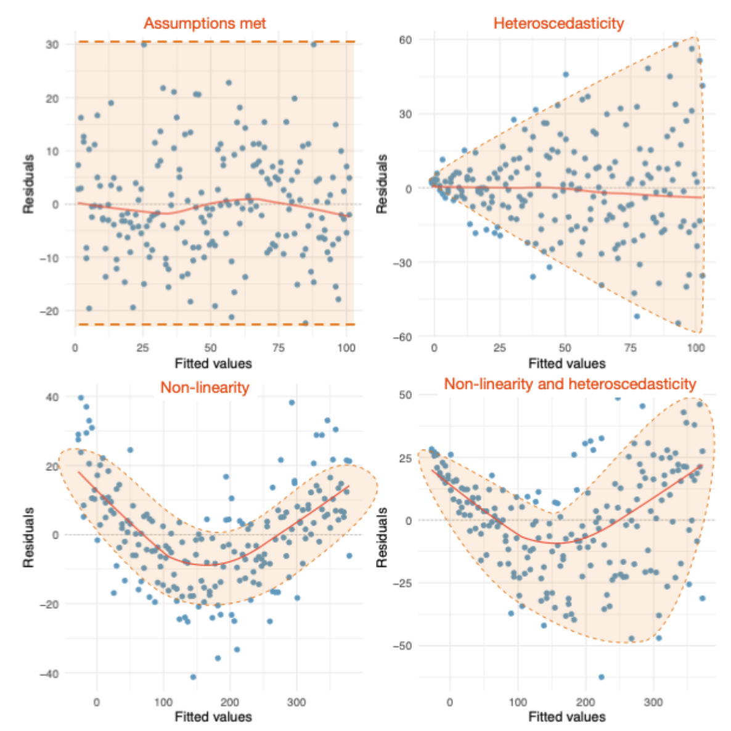
Assumptions (a reminder…)

Slide 33
Assumptions (a reminder…)
Additivity and linearity
Spherical residuals
Homoscedasticity: For each value of the predictors the variance of the error term should be constant
Independent residuals: for any pair of observations, the error terms should be uncorrelated.
Normally-distributed errors
No Multicollinearity:
Predictors must not be highly correlated.
Notes:
Normal errors: the differences between the predicted and observed data are most frequently zero or very close to zero, and that differences much greater than zero happen only occasionally. Some people confuse this assumption with the idea that predictors have to be normally distributed, which they don’t.
In small samples a lack of normality invalidates confidence intervals and significance tests, whereas in large samples it will not because of the central limit theorem. If you are concerned only with estimating the model parameters (and not significance tests and confidence intervals) then this assumption barely matters. If you bootstrap confidence intervals then you can ignore this assumption.

Slide 34
Multicollinearity
Multicollinearity exists if predictors are highly correlated.
This assumption can be checked with collinearity diagnostics.
tolerance
variance inflation factor
Notes:
Multi-collinearity: If there is perfect collinearity between predictors it becomes impossible to obtain unique estimates of the regression coefficients because there are an infinite number of combinations of coefficients that would work equally well. The good news is that perfect collinearity is rare in real-life data (unless you made a mistake). The bad news is that less than perfect collinearity is virtually unavoidable. Low levels of collinearity pose little threat to the model estimates, but as collinearity increases there are three problems that arise: untrustworthy coefficients, limited power, can’t know importance of one predictor over another
other issues: Predictors are uncorrelated with ‘external variables’:
All predictor variables must be quantitative or categorical (with two categories), and the outcome variable must be quantitative, continuous and unbounded

Slide 35
Interpreting Model Parameters
b-values:
The expected change in the outcome associated with a unit change in the predictor.
Standardised b-values:
Tell us the same but expressed as standard deviations.

Slide 36
Logistic Regression
To predict an outcome variable that is categorical from one or more categorical or continuous predictor variables
Used because having a categorical outcome variable violates the assumption of linearity in normal regression
Example: Explain whether a person chooses/refuses a tutoring session, using their GPA and beliefs about intelligence (e.g., growth/fixed)

Slide 37
Interpreting Logistic Regression Model Parameters
b-values:
The expected change in the log(odds) of the outcome associated with a unit change in the predictor.
exponentiate the coefficient (e^{b}) to calculate the odds ratio.
e.g., odds ratio of 1.2 indicates that a one unit increase in the predictor means the odds of the outcome are 1.2 times the odds of the outcome without the increase in the predictor

Slide 38
Multinomial Logistic Regression
Logistic regression to predict membership of more than two categories.
It (basically) works in the same way as binary logistic regression.
The analysis breaks the outcome variable down into a series of comparisons between two categories.
E.g., if you have three outcome categories (A, B and C), then the analysis will consist of two comparisons that you choose:
Compare everything against your first category (e.g. A vs. B and A vs. C),
Or your last category (e.g. A vs. C and B vs. C),
Or a custom category (e.g. B vs. A and B vs. C).

Slide 39
Suppression
https://youtu.be/AHfUBqzWIkw?list=PLB2iAtgpI4YGoXjV-Ar_xuRIxvND9Q3WJ&t=525

